Slide 1
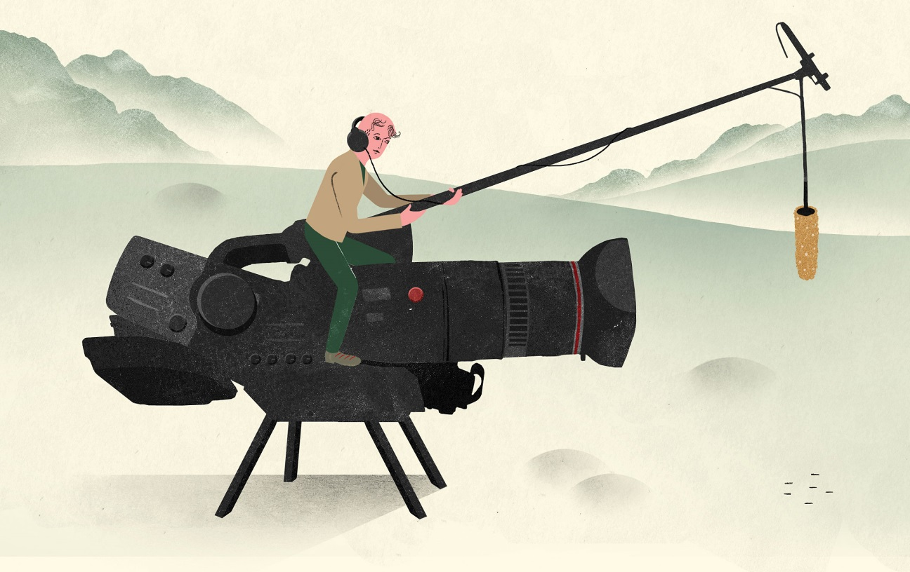
Documentary Films
Elements of Documentaries

Slide 2
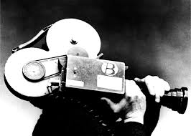
What do documentaries share with feature films?
Cinematography:
camera angles
Special effects
Lighting
Editing
Sound Design
Narrative

Slide 3
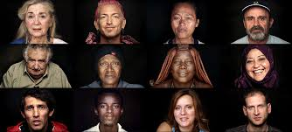
What Makes Documentaries Different?
The goal of a documentary is to present or re-present a glimpse of a non-fictional topic in order to give viewers insight into:
The human condition / life
The experiences of others
The environment/ Animals
A political movement past or present
Art
Science/ technology
Notes:
Documentaries rely LESS on narrative and MORE on providing an opinion and a specific, persuasive message, and information.

Slide 4
Stop, drop (your pencil), discuss:
Are docs different from reality TV?

Slide 5
Narration: Omniscient
Documentaries often rely on a narrator to provide:
Perspective / context / storyline
Information / data
Like a reporter, the narrator feels objective and is relied on for a sense of “truth”.
Sometimes documentaries use VOICE-OVERS, an all-knowing third person, a “voice-of-god”
Notes:
(omniscient). Interesting fact: Until recently, only men’s voices were used to narrate

Slide 6
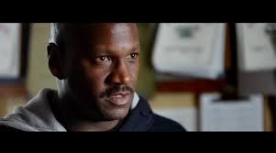
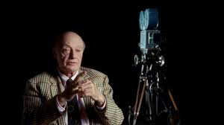
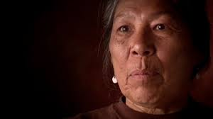
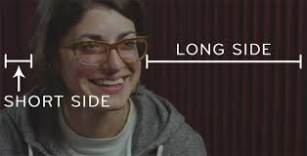
Narration and camera angle
The subject usually speaks to the camera using a rule of thirds shot.
Notes:
*This makes the audience feel that what they are watching is unfiltered, and therefore is more believable.

Slide 7
Modes
Notes:
Narrative continued

Slide 8
Authority and Expertise
Experts are used to provide facts or the “official” version of the story. They provide credibility.
Eye witness/Everyday People provide the human element. Usually they offer testimonials, which help to balance expert fact with firsthand, personal experience or opinion.
Notes:
Their authority comes from raw emotion and a why would they lie impression of the audience.

Slide 9
Information, not entertainment
photographs
Archival footage
Reenactments
Documents
Charts/ Graphs
Maps
Statistics
Computer simulations/ animations

Slide 10
The Cinematographic Style
Texture refers to the mixture of still and moving images, different evidence types, and different grains of film: vintage, handheld, etc.

Slide 11
Editing
Documentaries aim to suggest that they are a window on reality.
They usually appear low-budget in order to feel more real.
Notes:
(either because they are or because that makes them seem more spontaneous and “real”.

Slide 12
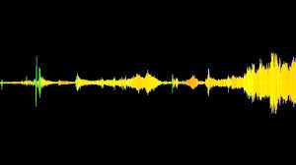
Music and Sound
Music usually includes theme music (usually for opening and closing credits) and licensed music (from popular artists).
The music is always chosen to accompany the images (creates added meaning).
Sound has a “live” feel to it (e.g. background noise is not edited out). Equally important to consider are added sound effects and silence. Why do you think that is?

Slide 13
Tone
Usually documentaries have a serious tone, so the film isn’t taken lightly.
But, Recently a new genre of “mockumentary” has emerged (e.g. Religulous by Bill Maher which mocks religious faith around the world)
http://www.youtube.com/watch?v=ZhI17Ky3fNg

Slide 14
Constructing Reality
A documentary is, in the end, a construction of reality, edited and manipulated by the documentarian and crew. That doesn't mean it isn’t true, but it’s not “the truth”, but rather “a truth”.
– What is the difference?

